Slide 1


We are watching you

Slide 2
Who am I?
Josh Conway (CrankyLinuxUser)
FCC Amateur radio: KC9JEF Facial Recog for your ‘Con (CPU bound, no gpu, no internet) https://hackaday.com/2015/03/04/face-recognition-for-your-next-con/ Multisite Home/Office/Hackerspace Automation
https://hackaday.io/project/12985-multisite-homeofficehackerspace-automation
Thalmic Labs(North) Shuts Down Free Developer Access Update: It’s Back Again https://hackaday.com/2014/11/18/thalmic-labs-shuts-down-free-developer-access/

Slide 3
What is this “Radio” thing?

Slide 4
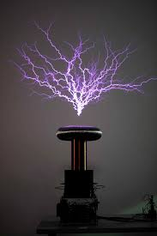
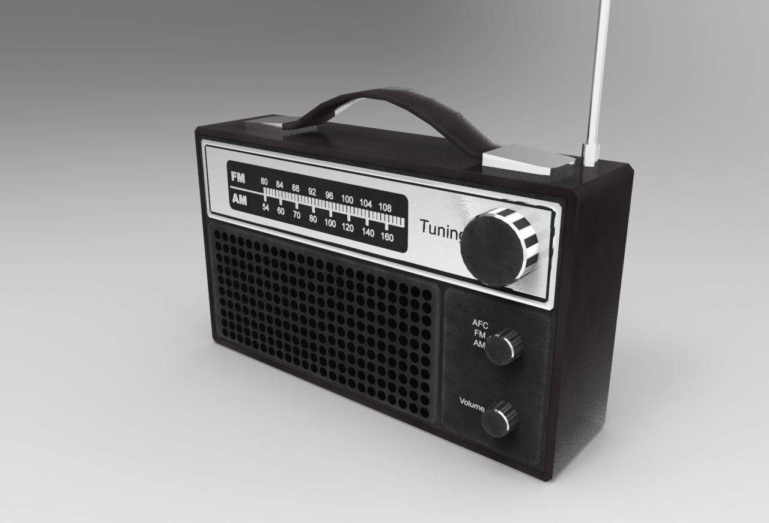
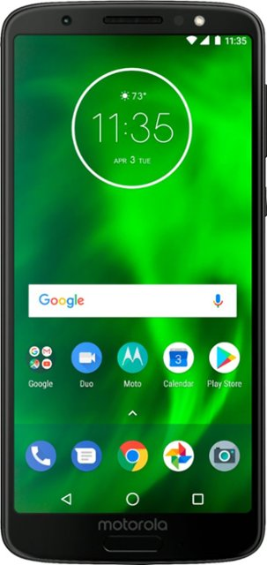
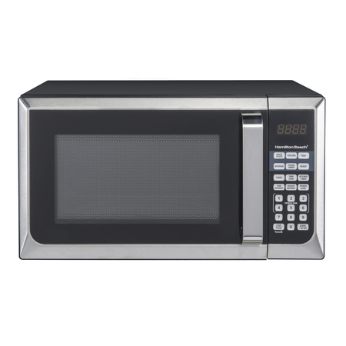

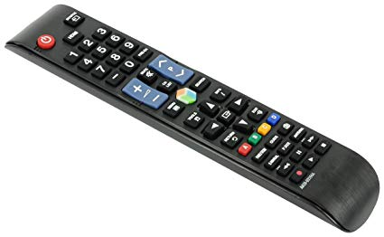
Is this a radio? Is that a radio???

Slide 5
They all are!
Definition (noun): The transmission and reception of electromagnetic waves of radio frequency, especially those carrying sound messages.
Definition (verb): communicate or send a message by radio.

Slide 6
Signals Intelligence
Signals intelligence (SIGINT) is intelligence-gathering by interception of signals, whether communications between people (communications intelligence—abbreviated to COMINT) or from electronic signals not directly used in communication (electronic intelligence—abbreviated to ELINT).
-- Wikipedia
BUT WHY DO WE CARE???

Slide 7

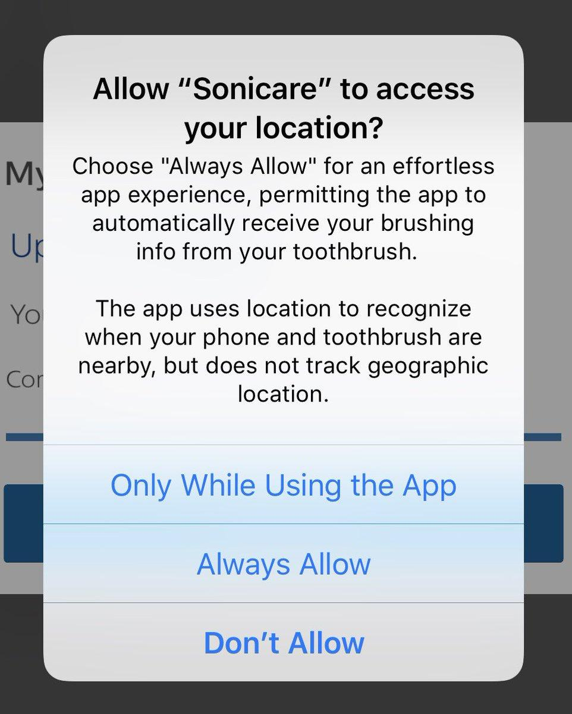

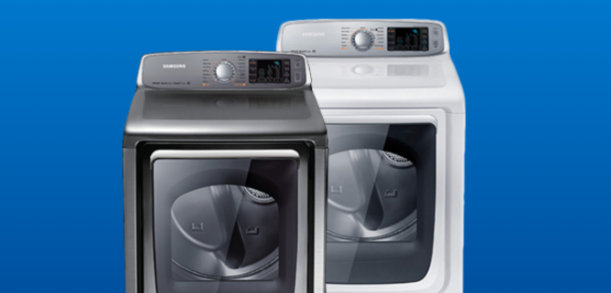
Common household things… Right?

Slide 8
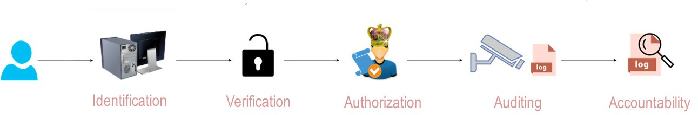
Security? Not if we can get away without it!
How many of these are implemented on radios you own?
Are they secure?
Are you sure???

Slide 9
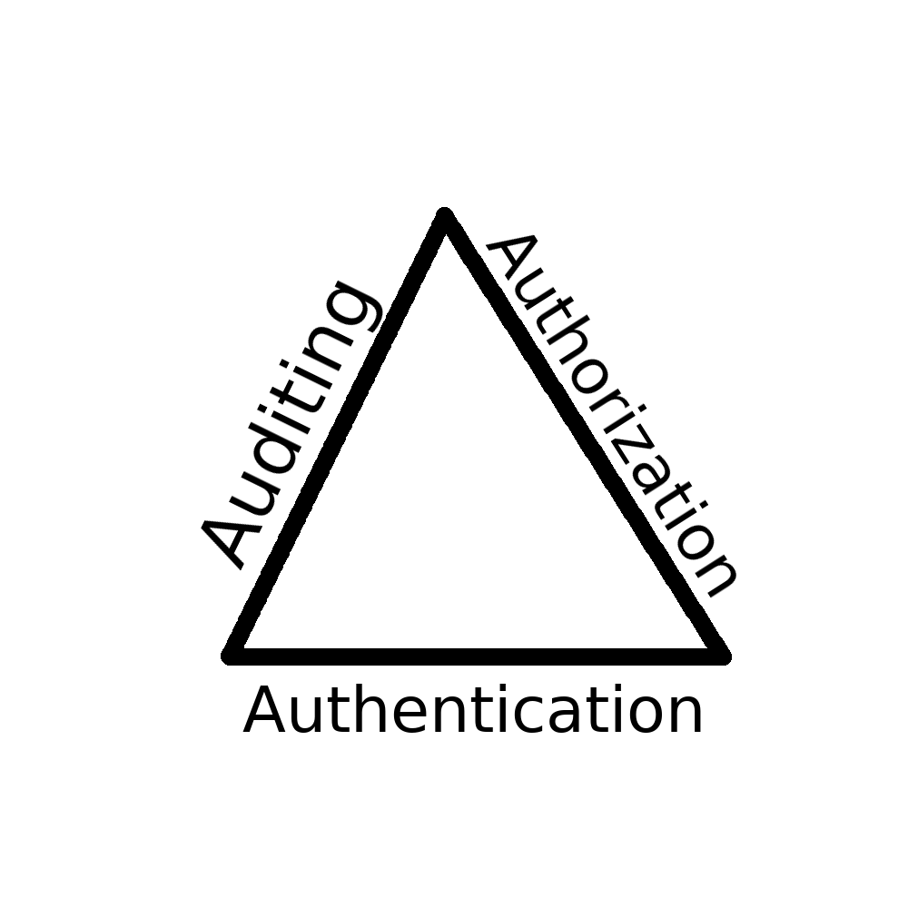



…. Don’t mind if I do!
Unknown
hardware
Unencrypted

Slide 10

RadioInstigator

Slide 11
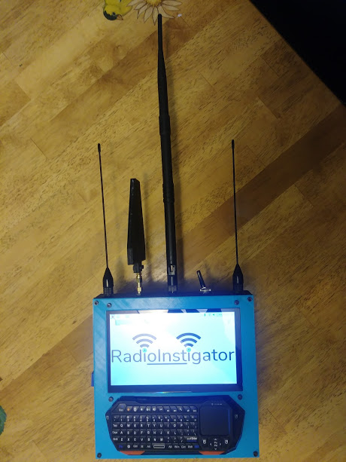
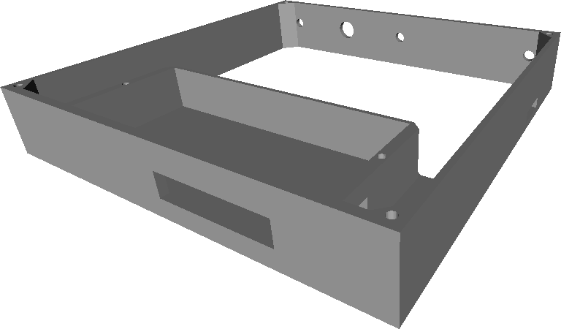
My Platform - A $150 Signals Intelligence Tablet
Raspberry Pi 3 B+
HDMI Touchscreen
RTL-SDR
Keyboard
Cool prints!

Slide 12
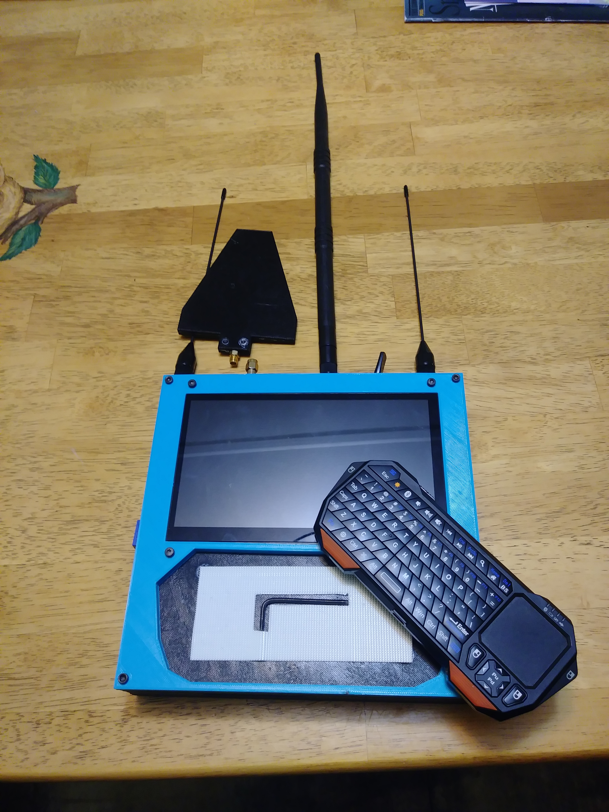
How I built it

Slide 13
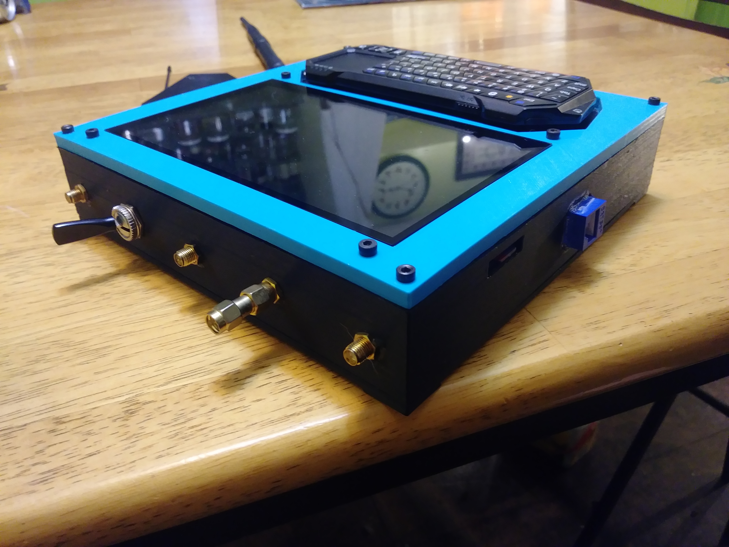
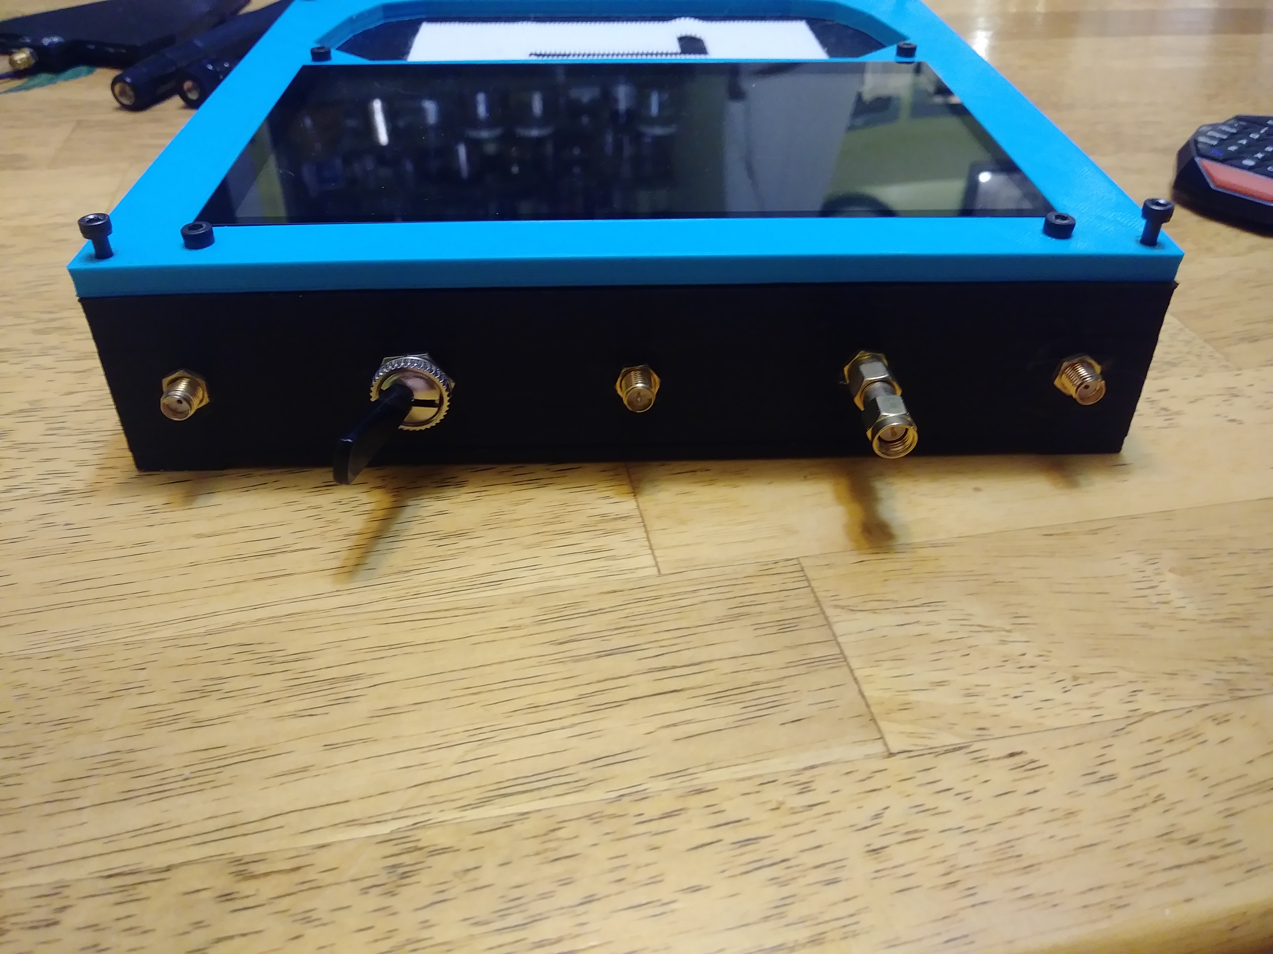
How I built it - Profiles
SMA (RX)
SPST
SMA (TX)
SPST
SMA (TX)
RP-SMA
Wifi
CrazyRadio
2.4GHz
Ethernet
RP-SMA
Wifi
CrazyRadio
2.4GHz
SMA (RX)

Slide 14
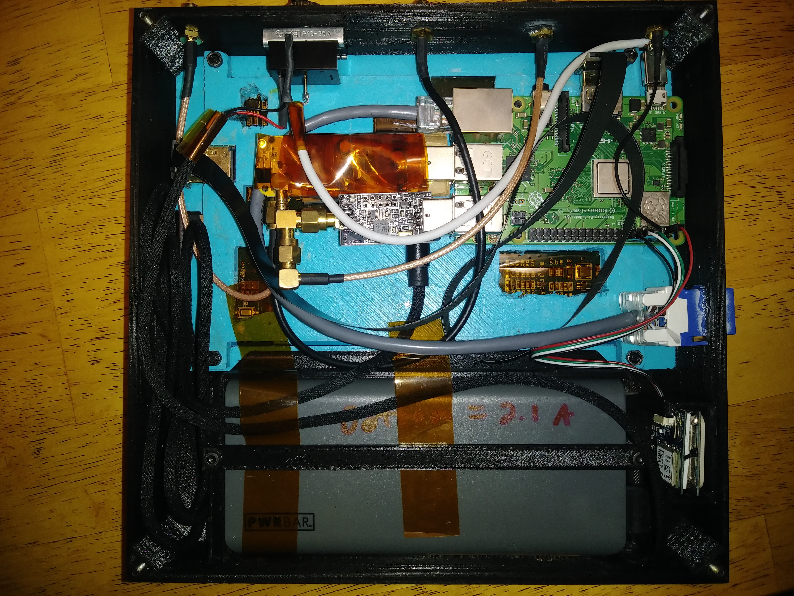
SPST
Wifi (RP-SMA)
CrazyRadio
SMA (RX)
SMA (TX)
Raspberry Pi 3B+
Top: RTL-SDR
Bot: Wifi
Ethernet
Top: CrazyRadio
Bot: HDMI Touch
Screen
GPS
Battery

Slide 15

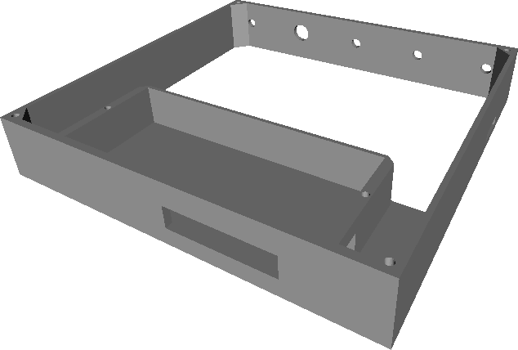
Printables
Backplane
6 hr print
Exterior back
15 hr print

Slide 16
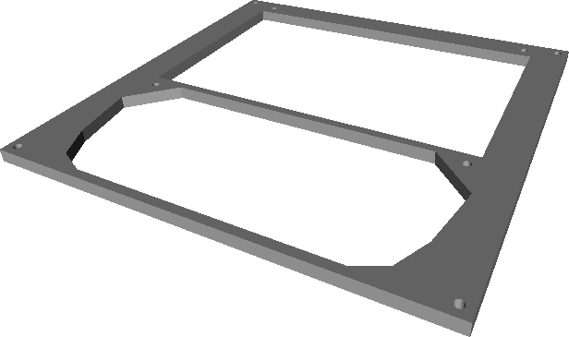
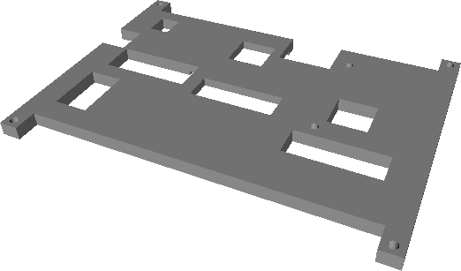

Printables
Battery retaining bar
30 min print
Front Bezel
5 hr print
LCD Backplane
5 hr print

Slide 17
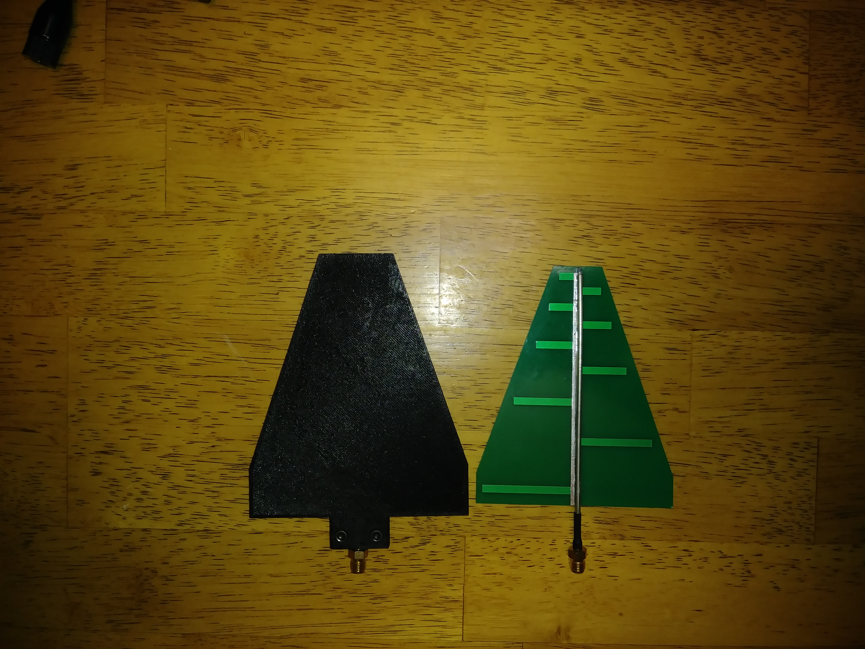
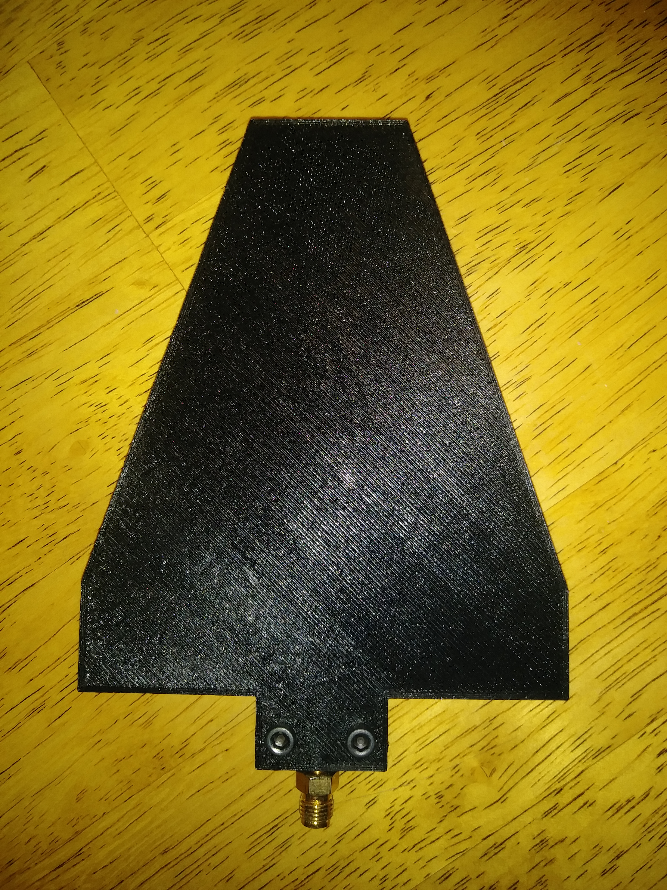
Even the antennas are custom…

Slide 18
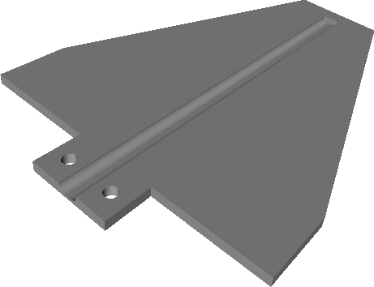
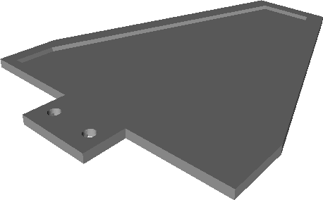

Printables (Optional)
Antenna case
5 hr print (combined)
GPS holder
1 hr print

Slide 19

You want to build one?
Raspberry Pi 3B+ (Tx!!)
Touchscreen
RTL-SDR (RX)
CrazyRadio (duplex, keyboards/mice)
SMA stuff
3d printed stuff
GPS - optional

Slide 20
SigInt on a shoestring or Dirty SigInt Deeds Done Dirt Cheap

Slide 21
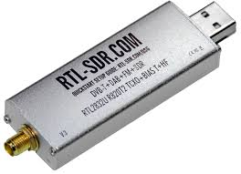
The Notorious RTL-SDR
GOOD | BAD
Cheap Easy to obtain 24MHz-1766MHz 2.4MHz Bandwidth (window) | Cheap Sometimes dubious build quality Janky included antennas

Slide 22
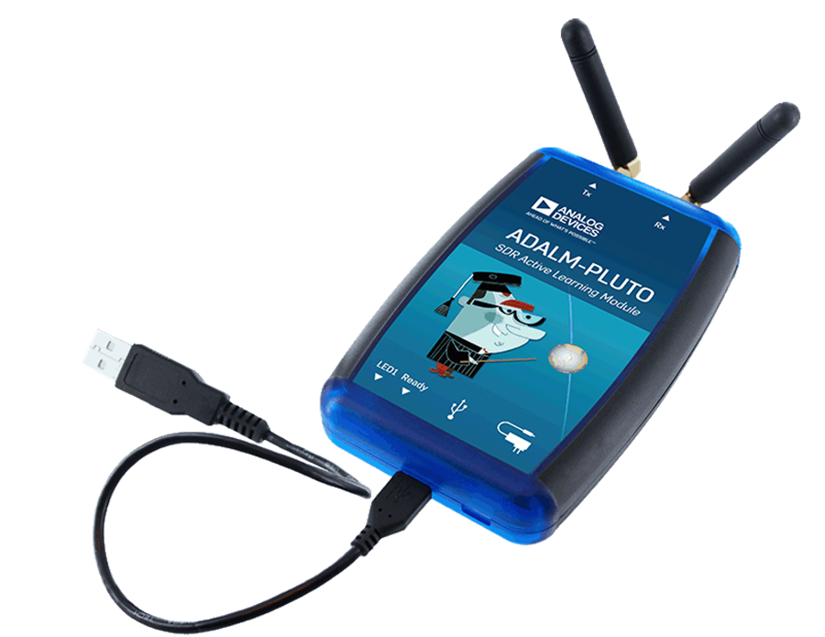
ADALM-PLUTO
GOOD | BAD
$100-$150 Uber-hackable (dual core Arm with Linux) 70MHz-6GHz (?!) 20MHz Bandwidth (window) Can run programs on device! | Can be hard to obtain 5mW Tx Janky included antennas USB2 limits overall bandwidth

Slide 23
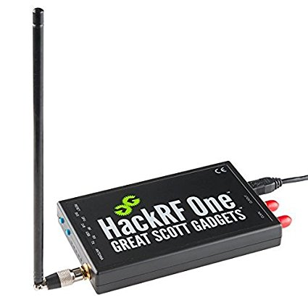
HackRF
GOOD | BAD
~$300 Very well supported 1MHz-6GHz (?!?!) Sweep Mode – 8GHz/second | Simplex (Can Tx or Rx, not at the same time) 8 bit IQ

Slide 24
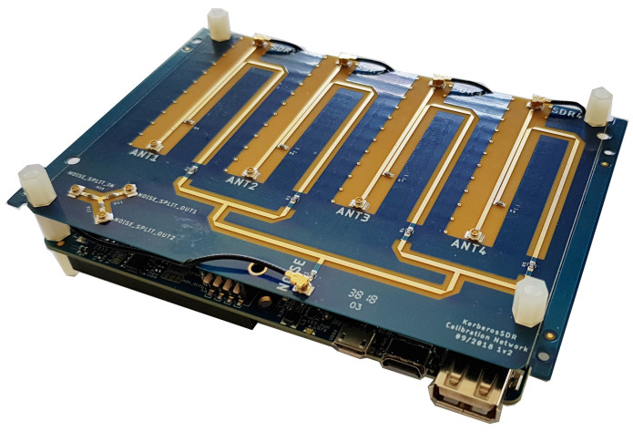
KerberosSDR
GOOD | BAD
~$125 Coherent Quad RTL-SDR 24MHz-1.7GHz | Toolchain very ‘raw’ because new 8 bit IQ

Slide 25
Antennas … Because the default ones aren’t good

Slide 26
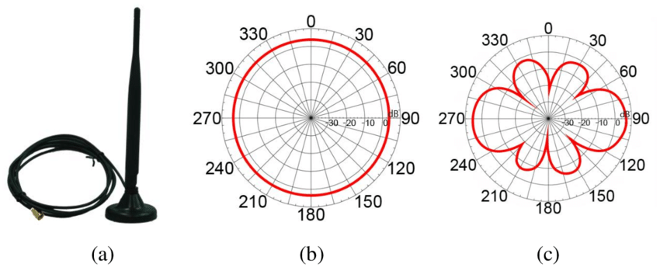
Omnidirectional Antennas
Horizontal
Polarization
Vertical
Polarization

Slide 27
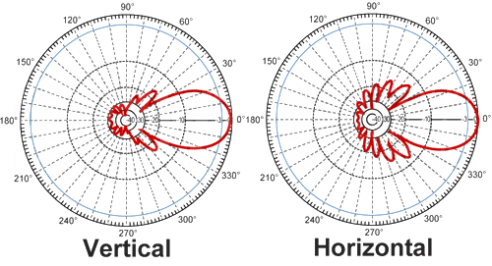
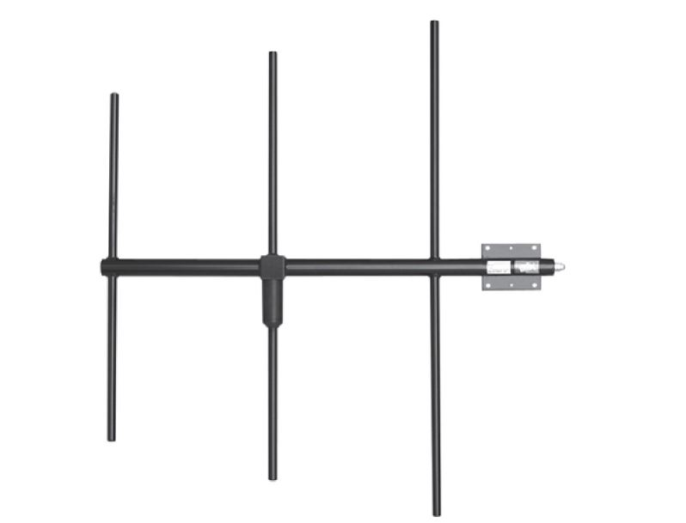
Yagi Antennas

Slide 28
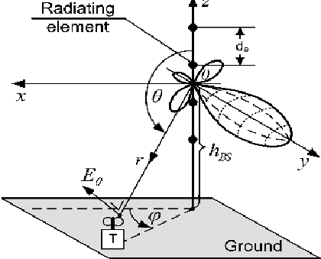
Yagi Antennas cont’d

Slide 29
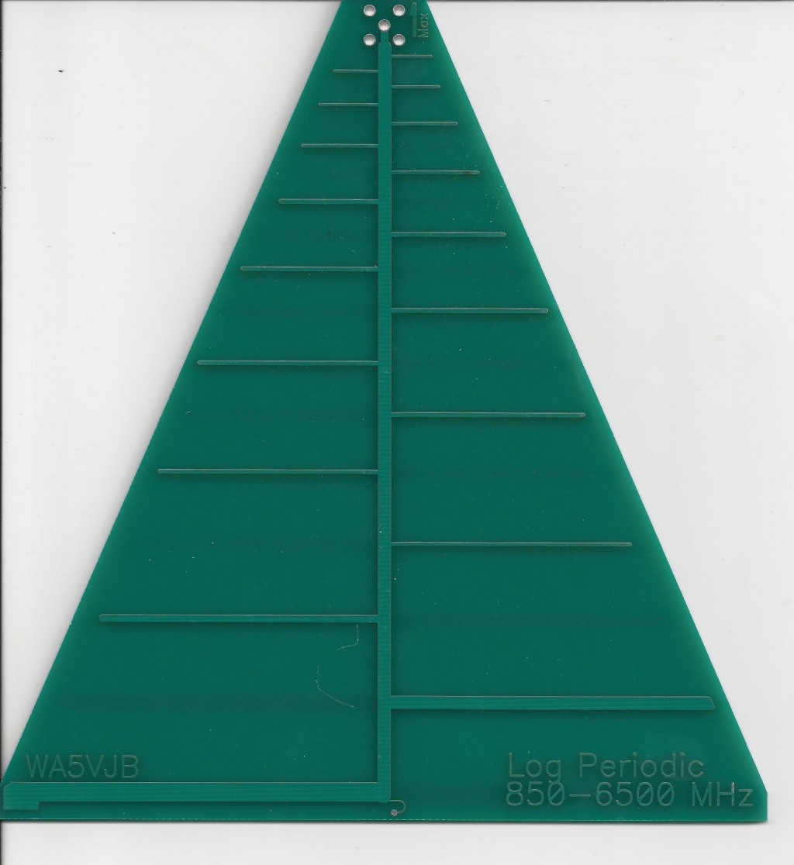
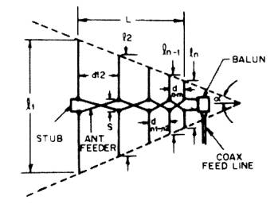
Log Parabolic Antennas

Slide 30
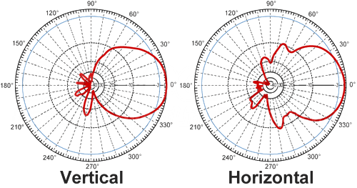
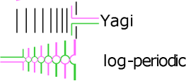
Log Parabolic Antennas

Slide 31
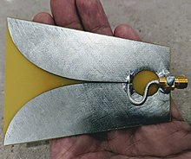
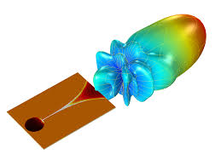
Vivaldi Antennas

Slide 32
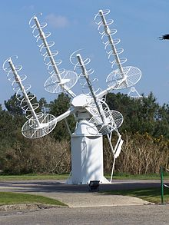
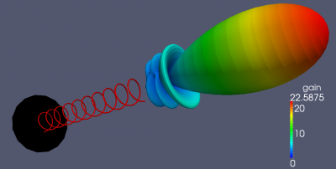
Helical Antennas

Slide 33
Software You want to make that hardware work, right?

Slide 34


Software Whisperer
(OS, Libraries)
Obviously!

Slide 35
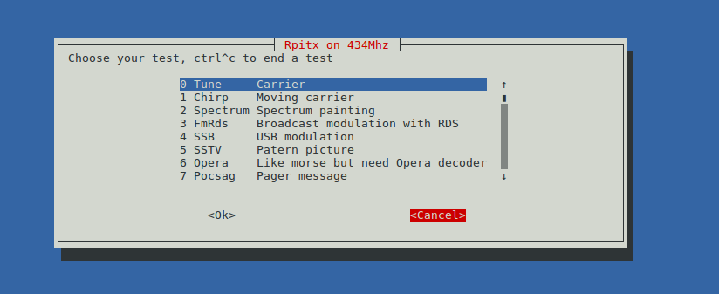
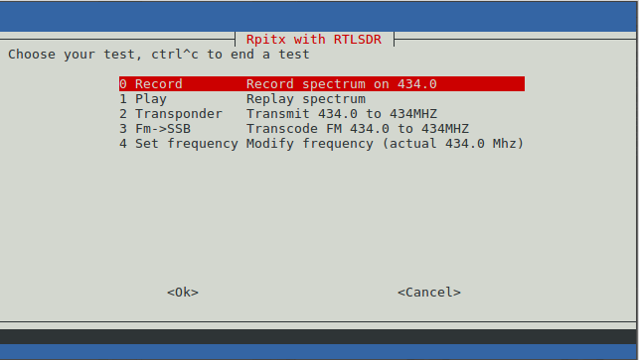

RPITX – The lib that makes this platform
Realtime TX mkfifo /tmp/rpitx.fifo
sudo rpitx -m IQ -i /tmp/rpitx.fifo -f 434000 -l

Slide 36
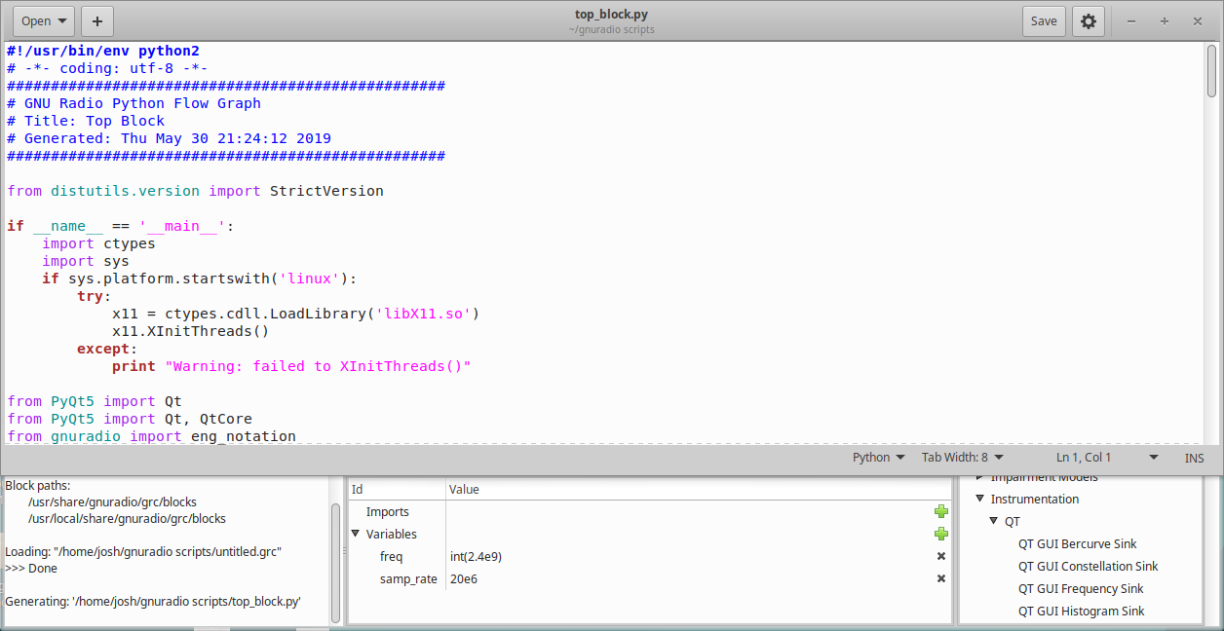
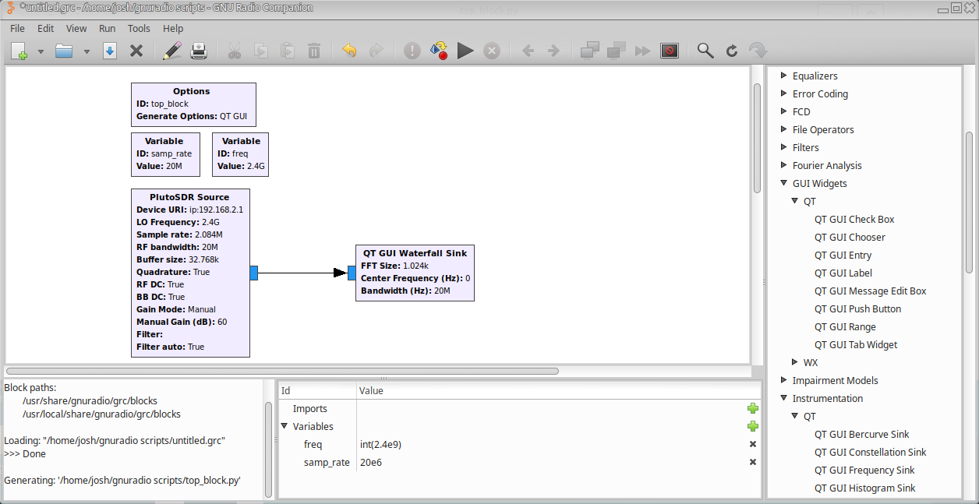
GnuRadio Companion
GNURADIO IS PYTHON WITH A PRETTY GUI

Slide 37
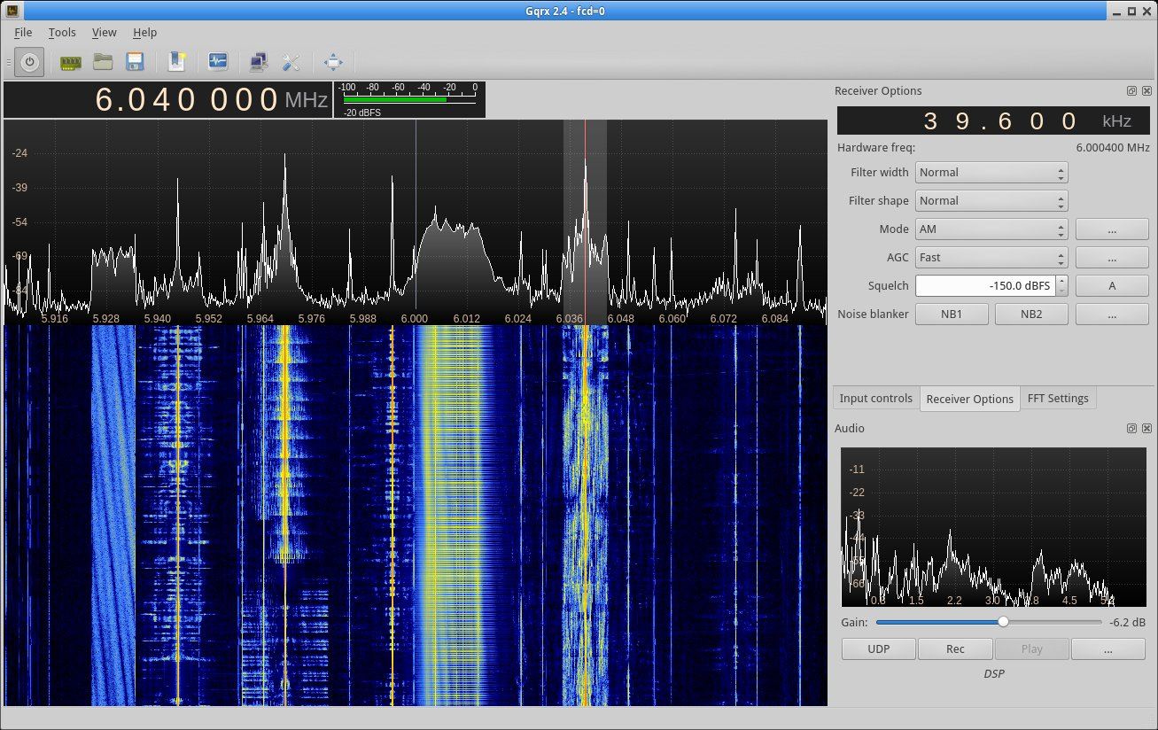
GQRX
Easy
Fast to set bookmarks
Quick to save IQ data
Supports few protocols
Can chew through resources
Crashy

Slide 38
URH – Universal Radio Hacker

Slide 39

URH – Universal Radio Hacker
Exceptional set of videos by
Johannes Pohl – creator of URH

Slide 40
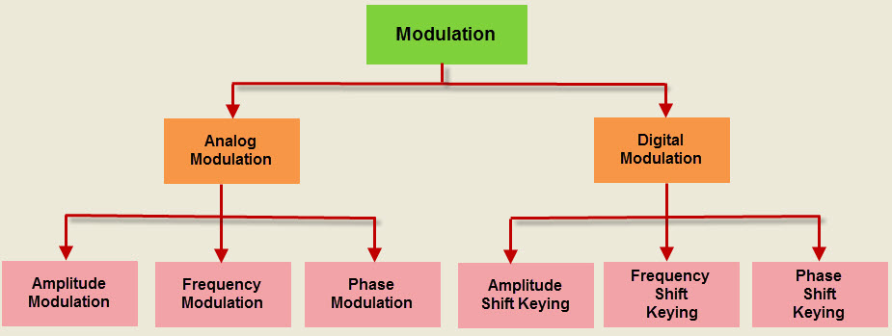
Basics behind URH

Slide 41
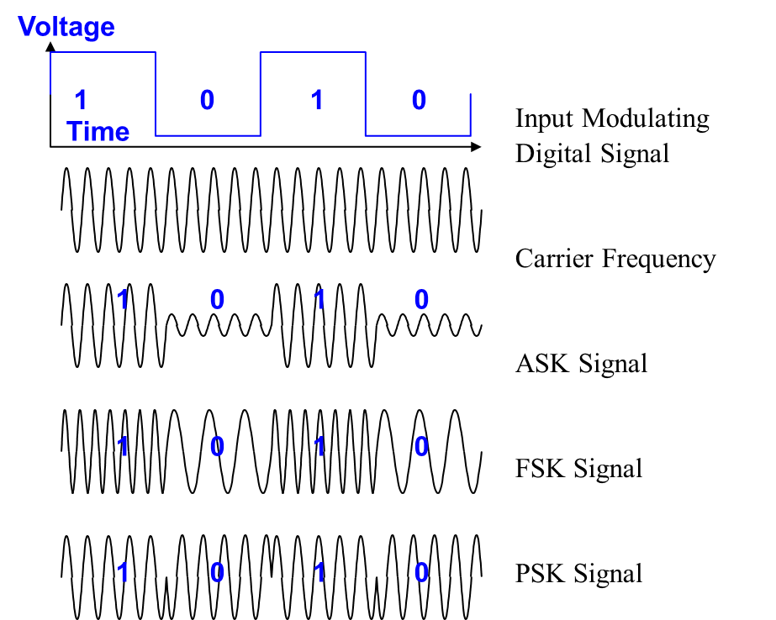
Basics behind URH

Slide 42
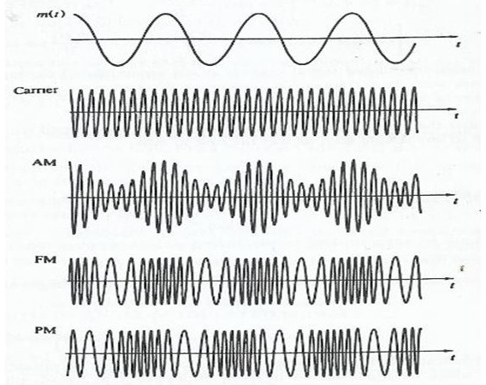
Basics behind URH

Slide 43
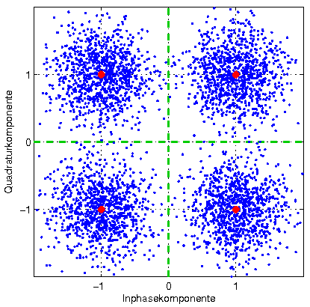
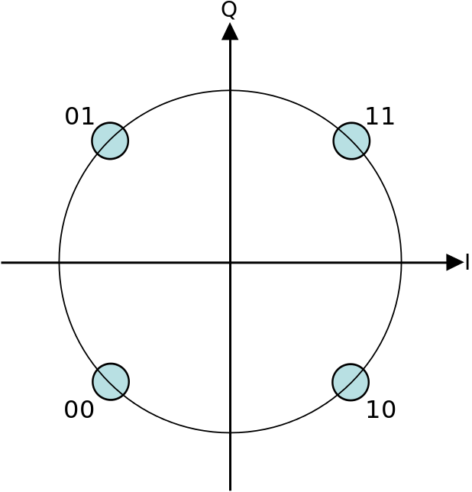
Basics behind URH And then it gets crazy…
4QAM - Quadrature Amplitude Modulation

Slide 44
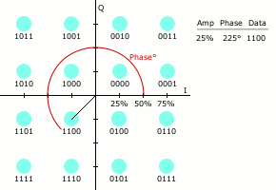
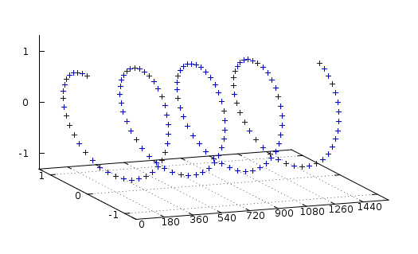
Basics behind URH 16QAM – 4096QAM ?!

Slide 45

Salamandra - Spy Microphone Detector
Needs a speaker
Can find audio bugs

Slide 46

TempestSDR - Every Monitor is Wireless
Allows viewing of monitors!
Lots of tuning variables
Autotuning
Needs more bandwidth than RTL-SDR
Chews through CPU

Slide 47
Demotime….

Slide 48

What can we do about this?

Slide 49

It is “technically” a choice…

Slide 50

Hope you aren’t vulnerable

Slide 51

Where do we go from here?
Briefcase sized with more transceivers
Redesign with 6x18650
Write networking code to combine many tablets
Automate continuous scanning mode
Make a scanning/submission network for classifying signals
More bandwidth and more spectrum!

